Slide 1

The Breakthrough Pitch
Strategies for success in tomorrow’s markets

Slide 2

Introduction
The Breakthrough Pitch
0.1
The Breakthrough Pitch, developed by Volans in partnership with the UN Global Compact, and with support from Generation Foundation, is designed to help you stretch the sustainability ambitions of your business.
Build your own Pitch
Spend time absorbing the pitch and think about how it applies to your business’ context.
Customize the deck by adding or removing slides to make it more relevant to your audience.
Have next steps in mind before you present and be clear about the specific ask you want to make at the end of your pitch.
Use the Guide
The User’s Guide to
The Breakthrough Pitch
available for download on www.projectbreakthrough.io contains detailed speaker notes, including key messages, useful background and links to further reading for each slide.
The guide will also help prepare you to deal with questions and challenges your audience might raise.
Copyright @2017 Volans. This work is licensed under the Creative Commons Attribution 4.0 International Licence (CC by 4.0). The Breakthrough Pitch is produced by Volans, in association with the UN Global Compact. The contents reflect the opinion of its authors and do not necessarily represent the views of the UN Global Compact. Readers are encouraged to use or reproduce material for their own publications, as long as Volans and the UN Global Compact are given appropriate attribution. Design by Rupert Bassett.

Slide 3
Outline
The Breakthrough Pitch
0.2
1.0
A new growth story
2.0
Disrupt or be disrupted
3.0
Rebooting the
C-suite agenda
4.0
Next steps on the
Breakthrough journey

Slide 4
1.0
The Breakthrough Pitch
A new growth story

Slide 5

A new growth story
The SDGs as a crowd-sourced market agenda
The Breakthrough Pitch
1.1
The Sustainable Development Goals (SDGs) are a market agenda for the 2020s—
in effect, a purchase order from the future.
While many champions of the SDGs focus on incremental change, the Goals also represent an exponential change agenda. Even if they targeted 2050, rather than 2030, goals like ‘No Poverty’ and ‘Zero Hunger’ would demand exponential progress.

Slide 6
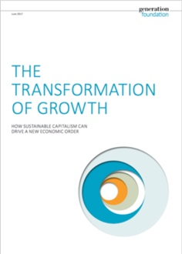
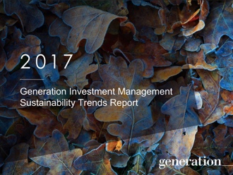
A new growth story
The Sustainability Revolution is here
The Breakthrough Pitch
1.2
A 2017 white paper by the
Generation Foundation heralds the ‘Sustainability Revolution’, bringing off-the-scale opportunities for business.
The Sustainability Revolution appears to have the scale of the Industrial Revolution and the Agricultural Revolution – and the speed of the Information Revolution. Compared to these previous revolutions, the Sustainability Revolution is likely to be the most significant event in economic history.”
The Transformation of Growth 2017
“
Source: Generation Foundation
Note: Generation Investment Management’s 2017 Sustainability Trends Report documents the trends behind this Revolution.

Slide 7
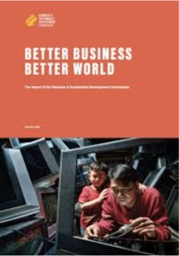
A new growth story
$12 trillion a year markets by 2030
The Breakthrough Pitch
1.3
SDG-related market opportunities are forecast to be worth at least $12 trillion a year in revenue and savings by 2030.
Markets mapped across four value creation nexuses
Source: Business and Sustainable Development Commission
Health and well-being
Food and agriculture
Cities and urban mobility
Energy and materials

Slide 8
A new growth story
Going for breakthrough
The Breakthrough Pitch
1.4
Exponential challenges demand exponential solutions. Incremental approaches, while important, are no longer sufficient.
Around the world, breakthrough innovators are already creating positive impact at scale by combining new mindsets, technologies and business models. Find out more at projectbreakthrough.io
Source: Volans

Slide 9
2.0
The Breakthrough Pitch
Disrupt or be disrupted

Slide 10

Disrupt or be disrupted
Technology in the driving seat
The Breakthrough Pitch
2.1
“
From next generation robotics to autonomous vehicles, and from artificial intelligence to gene editing – a range of new technologies are emerging and converging at an exponential pace.
We stand on the brink of a technological revolution that will fundamentally alter
the way we live, work, and relate to one another.”
The Fourth Industrial Revolution 2016
Project Breakthrough features a series of 12 briefings on disruptive technologies, developed by PA Consulting. The briefings explore ways that business can use new technologies to address the SDGs – and introduces potential downsides to consider.
Source: WEF

Slide 11
Disrupt or be disrupted
Exponentials are hard to spot
The Breakthrough Pitch
2.2
Technologies that progress exponentially are often slow to achieve market penetration.
The underlying trajectories become much more obvious as tipping points are reached.
Where in our markets are such trends at work – or likely to emerge? Are we doing enough in response?
Market penetration over time
Exponential
Change
Incremental
Change
Visual adapted from Exponential Organizations by Salim Ismail, Michael Malone and Yuri van Geest (2014)
Disappointment
Amazement / Chaos

Slide 12
Disrupt or be disrupted
It’s not just technology that’s gone exponential
The Breakthrough Pitch
2.3
Key socio-economic and earth system trends started going exponential – for better and worse – around 1950, marked by the red line on the graphs.
The scale and speed of environmental change resulting from human (and business) activity is starting to have profound consequences for business in all sectors.
Visual adapted from a paper by Steffen, W., W. Broadgate, L. Deutsch, O. Gaffney and C. Ludwig (2015). The Trajectory of the Anthropocene: the Great Acceleration.
Key socio-economic trends
Key earth system trends

Slide 13
Disrupt or be disrupted
The future of transportation / 1
The Breakthrough Pitch
2.4
Transportation sits at the heart of the global economy. The disruptions it faces will have wide-reaching consequences – and are an indication of the kind of transformation other industries can expect.
In August 2017, The Economist forecast the death of the internal combustion engine.
Some of the disruptive trends behind this headline are explored on the next slide.

Slide 14
Disrupt or be disrupted
The future of transportation / 2
The Breakthrough Pitch
2.5
The proportion of passenger miles travelled in driver-owned cars is forecast to collapse, making way for ‘Transport as a Service’ (TaaS) models.
What are the implications for auto and oil companies? Where are similar dynamics playing out in other markets?
Speed of TaaS adoption
TaaS
miles
Individual ownership miles
Visual adapted from Rethinking Transportation 2020-2030 by
RethinkX (2017)

Slide 15
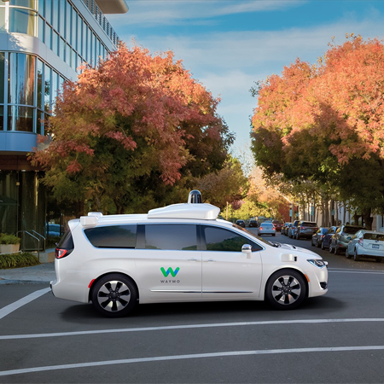
Disrupt or be disrupted
Time to think 10X
The Breakthrough Pitch
2.6
True innovation happens when you try to improve something by 10 times – rather than by 10%. A 10X goal forces you to rethink an idea entirely. It pushes you beyond existing models and forces you to totally reimagine your approach.”
Google
“
The Chrysler Pacifica Hybrid self-driving
car equipped with Waymo's driving software Waymo started out as a project at Google
in 2009, and spun out in 2015.
Source: Waymo website.

Slide 16
3.0
The Breakthrough Pitch
Rebooting the C-suite agenda

Slide 17
Rebooting the C-suite agenda
Changing mindsets
The Breakthrough Pitch
3.1
Becoming a breakthrough business isn’t just about technologies and business models. Fundamentally, it’s about mindsets and leadership.
In this section, we outline 5 key questions for leaders and executive teams, showcasing a range of established and emergent businesses where effective action is being taken.
Are we managing or leading?
Are we disrupted or disrupting?
Are we delivering %
or X?
Are we linear or circular?
Are we depleting
or creating
system value?

Slide 18
Rebooting the C-suite agenda
Are we managing or leading?
The Breakthrough Pitch
3.2
Leaders are curious. They embrace challenges, taking responsibility for their share of the problem, and spurring the quest for solutions.
1
Are we solving a global challenge through our core business? Are our goals ambitious enough?
2
What are our blindspots? Are we missing opportunities because our frame of reference doesn’t allow us to see them?
3
Are we largely focused on symptom management –
or do we seek to address
root causes?

Slide 19


Rebooting the C-suite agenda
Are we managing or leading?
Case studies
The Breakthrough Pitch
3.3
A sustainability pioneer
Interface was an early champion of corporate action on climate change. ‘Mission Zero’ (est. 1994) set the company on a course towards zero emissions.
Raising the level of ambition
Now Interface has a new goal: reversing global warming.
Its ‘Climate Take Back’ plan engages both internal and external stakeholders in actions to create a climate fit for life.
A triple bottom line company
Covestro assesses all R&D investment decisions against three criteria: impact on people, planet and profit.
SDG integration The company committed to align 80% of its R&D budget with sustainable development by 2025.
Reimagining carbon Covestro is a catalyst of ‘Carbon Productivity’ – a cross-sector initiative to create more value from less carbon.

Slide 20
Rebooting the C-suite agenda
Are we disrupted—or disrupting?
The Breakthrough Pitch
3.4
Leaders move beyond early,
defensive postures, embracing disruption
as a core element of their strategy.
1
Where is disruption happening – or likely to happen – in our sector, or in contiguous sectors?
2
Are there elements of our existing core business that we need to ‘let go’ in order to disrupt ourselves?
3
Do we have structures in place for tapping into new ideas, both within and outside the organization?

Slide 21


Rebooting the C-suite agenda
Are we disrupted—or disrupting?
Case studies
The Breakthrough Pitch
3.5
Getting ahead of the curve
GM launched the world’s first mass-market electric vehicle with a 200-mile range, in 2016.
Partnering with disruptors
It has made investments in companies disrupting the automotive industry, including Lyft (transport as a service) and Cruise (autonomous vehicles).
Shifting strategic focus
The company is changing its focus from vehicle manu-facturing to urban mobility.
Getting out of fossil fuels
Ørsted (formerly DONG Energy) tripled its share of energy generated from renewable sources in a decade. It moved away from coal and invested in offshore wind at a time when the latter was an immature technology.
Disrupting business as usual
It put a significant proportion of its operating income at risk in order to align its business with long-term sustainability.

Slide 22
Rebooting the C-suite agenda
Are we delivering % or X?
The Breakthrough Pitch
3.6
Incremental improvement remains
important, but is no longer sufficient.
To address emerging threats and opportunities, we need exponential
solutions.
1
Do we have a purpose and culture that inspires employees to think exponentially?
2
What aspects of our business are most likely to benefit from a 10X approach – or similar?
3
Do we have teams dedicated to identifying and experimenting with exponential approaches?

Slide 23


Rebooting the C-suite agenda
Are we delivering % or X?
Case studies
The Breakthrough Pitch
3.7
Using tech to scale fast
In 7 years, BIMA has registered more than 27 million customers for its insurance products.
It has achieved this by leveraging mobile technology that is now ubiquitous even in many poor communities.
Accessing new markets
93% of BIMA’s customers earn less than $10 a day; 54% earn less than $2.50 a day.
A 25X reduction in water use
Levi Strauss & Co has successfully reduced the water used in the finishing process for its jeans by 96% since 2007.
Open-sourcing innovation
The company has open-sourced its ‘Water<Less’ techniques so that others in the industry can adopt them. If adopted across the industry, this could save up to 50 billion litres of water by 2020.

Slide 24
Rebooting the C-suite agenda
Are we linear or circular?
The Breakthrough Pitch
3.8
Optimizing financial and non-financial assets requires, in many cases, a shift from linear to closed-loop models.
1
Which flows (e.g. knowledge, resources, talent) are critical to our business?
2
Where in our business are linear models currently in use that could be turned into closed loops?
3
Which problematic outputs
(e.g. waste, GHG emissions) can be turned into valuable inputs?

Slide 25


Rebooting the C-suite agenda
Are we linear or circular?
Case studies
The Breakthrough Pitch
3.9
Selling light as a service
Prompted by a challenge from architect Thomas Rau, Philips Lighting now offers light as a service on a ‘pay-per-lux’ basis. The company retains ownership of the light fittings – taking responsibility for the entire product lifecycle.
Connected LED lighting
Philips now offers connected LED lighting as a service – enabling companies, households and cities to radically reduce energy usage.
A closed-loop model
By using waste as a resource, IKEA has reduced costs at the same time as reducing environmental impact. As of 2016, it was sending just 15% of waste to landfill globally.
Engaging whole value chain
In order to meet its goal of having a net positive environmental impact by 2020, the company is working with its entire value chain – customers, suppliers and employees.

Slide 26
Rebooting the C-suite agenda
Are we depleting or creating system value?
The Breakthrough Pitch
3.10
Leaders know that their value to society depends on their willingness to help change dysfunctional elements of systems they may still benefit from.
1
What are the areas of greatest risk and opportunity to our business? How can we become part of the solution?
2
How can we work with cities, industry bodies and cross-sector platforms to effect system change?
3
How do our current advocacy and lobbying efforts engage the system change agenda?

Slide 27


Rebooting the C-suite agenda
Are we depleting or creating system value?
Case studies
The Breakthrough Pitch
3.11
Collaborating with your peers
Working with other larger companies, Patagonia helped initiate the Sustainable Apparel Coalition, whose 175 members now account for more than 40% of the global apparel industry.
Investing in the ecosystem
Through its own investment fund, Tin Shed Ventures, it supports an ecosystem of companies working to eliminate the negative impacts of business on the environment.
Fixing a broken system
Novo Nordisk, the world’s leading producer of insulin, recognizes that the spread of diabetes, if unchecked, could lead to systemic breakdown.
Working with cities
It helped establish the Cities Changing Diabetes programme – a cross-disciplinary platform to map and analyze root causes of urban diabetes and identify scalable prevention solutions.

Slide 28
Rebooting the C-suite agenda
From Breakdown to Breakthrough
The Breakthrough Pitch
3.12
Let go of whatever doesn’t fit with tomorrow’s realities
Embrace uncertainty and discomfort
Experiment with and implement new business models
Stand back and scan
emerging trends
Identify opportunities for
10X thinking and solutions
Engage with perspectives
of disruptive innovators
Use the SDGs as
a north star
Zone of maximum confusion

Slide 29
The Breakthrough Pitch
4.0
Next steps on the
Breakthrough journey

Slide 30
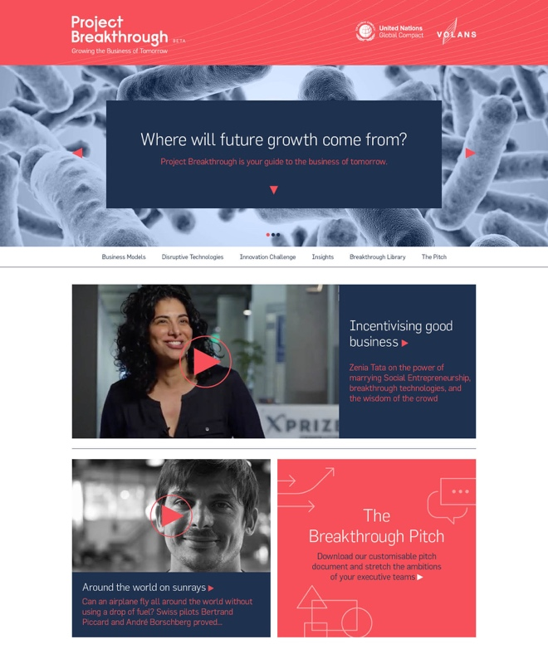
Next steps on the Breakthrough journey
Tools and resources
The Breakthrough Pitch
4.1
Project Breakthrough examines the technologies, business models and mindsets needed to deliver the Sustainable Development Goals.
The site features a set of interviews with pioneers of Breakthrough change – offering insights into what drives them and helps them succeed – and a suite of tools and resources to help business leaders drive Breakthrough innovation in their organizations.
Website
projectbreakthrough.io
Medium
/projectbreakthrough
Twitter
@Breakthrough_IO
Facebook
/ProjectBreakthroughIO

Slide 31


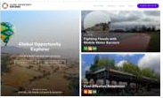
Next steps on the Breakthrough journey
Tools and resources
4.2
The Breakthrough Pitch
Blueprint for Business Leadership on the SDGs
Developed by the UN Global Compact, the Blueprint aims to inspire all business to take leading action in support of the achievement of the SDGs.
www.unglobalcompact.org/library/5271
Better Business,
Better World report
The Business & Sustainable Development Commission’s flagship report is a must-read guide to SDG-related market opportunities.
report.businesscommission.org
Global Opportunity
Explorer
A platform created by Sustainia, DNV GL and UN Global Compact showcasing the most innovative solutions addressing the SDGs.
www.globalopportunityexplorer.org

Slide 32
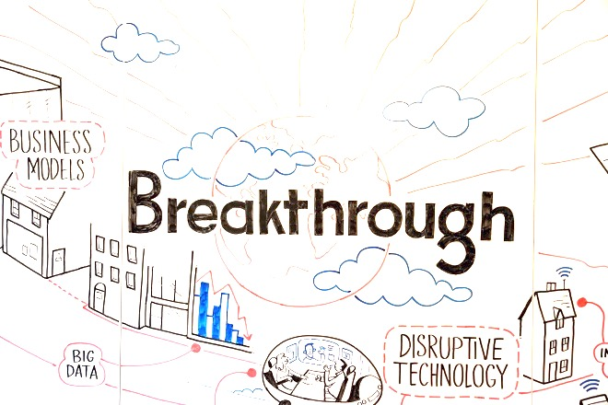



Next steps on the Breakthrough journey
Breakthrough Innovation for the SDGs Action Platform
4.3
The Breakthrough Pitch
To support companies in raising their sustainability ambitions, the UN Global Compact offers platform participants the opportunity to explore how disruptive technology and new business models can accelerate progress on the SDGs.
Through the platform, participants will gain insights on the applications of disruptive technologies, identify the business model innovations most relevant to their companies and receive support for integrating solutions into their sustainability initiatives.
Platform Partners
Platform Sponsors
www.unglobalcompact.org/take-action/action/breakthrough-innovation

Slide 33



Next steps on the Breakthrough journey
Breakthrough Innovation for the SDGs Action Platform
4.4
The Breakthrough Pitch
As part of the Break-through Innovation for the SDGs Action Platform, the inaugural Breakthrough Innovation Challenge brought together intrapreneurs from 7 UN Global Compact participant companies, challenging them to create sustainable business models using disruptive technologies.
Solutions developed include:
Braskem
A Challenge Prize focused on encouraging new solutions in agriculture that can optimize inputs whilst increasing yields/quality.
Enel
Green minigrids for
off-grid communities encompassing renew-able generation, batteries and a system of smart meters and pay-as-you-go technology.
Fuji Xerox
A communication platform using gamification and AI that allows employees to better connect, communicate and collaborate.
breakthrough.unglobalcompact.org/#innovation-challenges

Slide 34




Next steps on the Breakthrough journey
Breakthrough Innovation for the SDGs Action Platform
4.5
The Breakthrough Pitch
Iberdrola
An energy bank allowing users to purchase ‘days of energy’ (instead of kwh) at a cheaper rate up-front.
Natura
An app combining gamification, AI and Big Data that promotes collaboration whilst providing increased business opportunities to its sales consultants.
Nestlé
A digital app using Big Data and AI to help users minimize food waste by managing their groceries and planning their meals.
Sumitomo
Biosensors that help farmers measure crop maturity alongside an app offering farmers predictive analytics to make smarter harvesting decisions.

Slide 35

Next steps on the Breakthrough journey
Get in touch
4.6
The Breakthrough Pitch
The UN Global Compact is a leadership platform for the development, implementation and disclosure of responsible corporate practices. It is the largest corporate sustainability initiative in the world, with more than 9,000 companies and 3,000 non-business signatories globally.
Volans is a London-based transformation agency. We work with global companies, innovators, government actors and civil society to help them move beyond incremental change to address systemic challenges. Our work is focused on stretching thinking, mindsets and behaviors.
For information on the Breakthrough Innovation Action Platform, contact:
Rosedel Davies-Adewebi
Senior Manager, UN Global Compact rdaviesadewebi@unglobalcompact.org
For information on Project Breakthrough
and other Volans initiatives, contact:
Richard Roberts
Project Breakthrough Lead, Volans
r.roberts@volans.com

